Slide 1

SREENIDHI INSTITUTE OF SCIENCE AND TECHNOLOGY
(AN AUTONOMOUS INSTITUTION Approved by UGC)
Yamnampet, Ghatkesar, R.R. District -501 301
DEPARTMENT OF CSE- AI & ML
SUMMER INTERSHIP PROJECT -I SEMINAR
On
SMART MOBILE PHONE PRICE PREDICTION
BATCH NO : 606
Group Members:
NAALLA VENKATESHWARLU (21311A6606)
MALLA VENKATA SAI ASHISH (21311A6602)
THAKUR JAYANTH SINGH (21311A6604)
Internal guide
Guide name
Professor/Assistant Professor
Dept. Of CSE- AI & ML, ,SNIST
Project Coordinator
Mr.Gugulothu Ravi
Assistant Professor
Dept. Of CSE- AI & ML,SNIST
Head of the Department
Dr.T V Rajinikanth
Professor & HoD
Dept. Of CSE- AI & ML,SNIST

Slide 2
ABSTRACT
ABSTRACT: In this Modern Era, Smartphones are an integral part of the lives of human beings. When a smartphone is purchased ,many factors like the Display, Processor, Memory, Camera, Thickness, Battery, Connectivity and others are taken into account . One factor that people do not consider is whether the product is worth the cost .
Based on the accuracy , the appropriate algorithm has been used to predict the prices of the smartphone. This not only helps the customers decide the right phone to purchase , it also helps the owners decide what should be the appropriate pricing of the phone for the features that they offer
Different feature selection algorithms are used to identify and remove less important and redundant features and have minimum computational complexity. Ref[4]
Different classifiers are used to achieve the best possible accuracy. Results are measured in terms of achieving the maximum accuracy and choosing the minimum features.Ref[3]
Keywords: Machine learning, Random forest, Mobile cost prediction,Smartphone price prediction,Price prediction

Slide 3
INTRODUCTION
Machine learning algorithms can perform various tasks which are to be chosen with respect to the data to be worked with and the motive of the task.
Various tools and languages like Python, MATLAB, Java, WEKA, Cygwin, Octave, etc are available to perform machine learning tasks.
Examples of some frequently used algorithms include Naïve Bayes, K-NN, etc. Feature selection algorithms can be used to select and extract only the best parameters to train a model to optimize the accuracy and lessen the computational time of the model.
Any of these methods can be used to perform the task of predicting the price of a product depending on the type of data available to train the model.

Slide 4
WHAT IS MACHINE LEARNING?
Machine Learning is the field of study that gives computers the capability to learn without being explicitly programmed.
ML is one of the most exciting technologies that one would have ever come across.
As it is evident from the name, it gives the computer that makes it more similar to humans: The ability to learn.
Machine learning is actively being used today, perhaps in many more places than one would expect.
Machine learning is data driven technology. Large amount of data generated by organizations on daily bases. So, by notable relationships in data, organizations makes better decisions.
Machine can learn itself from past data and automatically improve.
From the given dataset it detects various patterns on data.
For the big organizations branding is important and it will become more easy to target relatable customer base.
It is similar to data mining because it is also deals with the huge amount of data.

Slide 5
PYTHON LIBRARIES USED IN THE PROGRAMS
Numpy- NumPy is a fundamental library for numerical computing in Python. It provides support for efficient and multidimensional arrays, along with a wide range of mathematical functions. NumPy is essential for creating and modifying arrays, performing mathematical operations on arrays, and handling large datasets efficiently.
Pandas- Pandas is a versatile library for data manipulation and analysis. It provides data structures like DataFrames that allow for easy handling and manipulation of structured data. Pandas is commonly used for cleaning and preprocessing data, transforming data into desired formats, and performing various data analysis tasks.
Seaborn- Seaborn is a statistical data visualization library built on top of Matplotlib. It provides a high-level interface for creating informative and visually appealing statistical graphics. Seaborn simplifies the process of creating various types of plots, such as scatter plots, bar plots, box plots, and heatmaps. It can also assist in identifying outliers in the data through visualizations.
matplotlib- Matplotlib is a widely-used plotting library in Python. It offers extensive flexibility for creating static, animated, and interactive visualizations. Matplotlib enables the creation of a wide range of plots, from simple line plots and histograms to complex 3D visualizations. It is often used in conjunction with other libraries, such as NumPy and Pandas, to visualize data and identify outliers.
Sklearn- Scikit-learn is a comprehensive machine learning library that provides various algorithms and tools for data analysis and modeling. It includes implementations of popular machine learning algorithms, such as regression, classification, clustering, and dimensionality reduction. Scikit-learn also offers utilities for data preprocessing, model evaluation, and model selection.
JobLib- Joblib is a library in Python that provides tools for efficiently saving and loading Python objects, especially large NumPy arrays. It is commonly used in conjunction with scikit-learn to store trained machine learning models and avoid retraining them from scratch.

Slide 6
RANDOM FOREST
Random Forest Regression in machine learning is an ensemble technique capable of performing both regression and classification tasks with the use of multiple decision trees and a technique called Bootstrap and Aggregation, commonly known as bagging.
The basic idea behind this is to combine multiple decision trees in determining the final output rather than relying on individual decision trees.
Random Forest has multiple decision trees as base learning models.
We randomly perform row sampling and feature sampling from the dataset forming sample datasets for every model. This part is called Bootstrap.

Slide 7
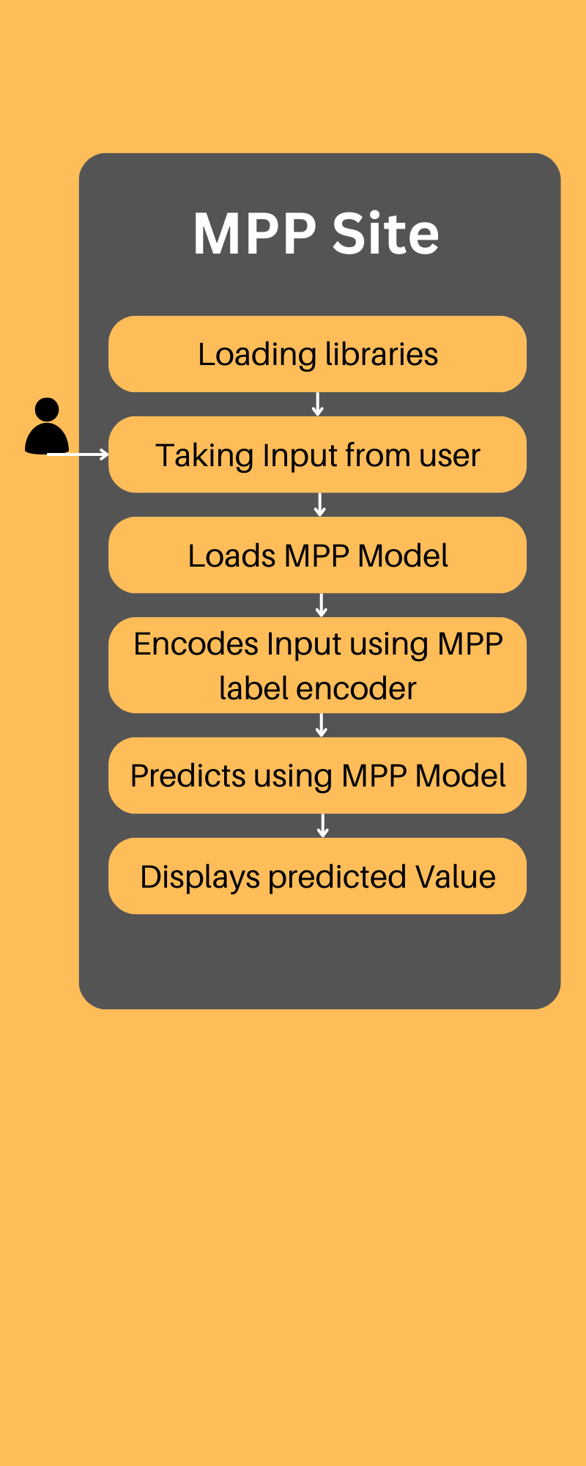
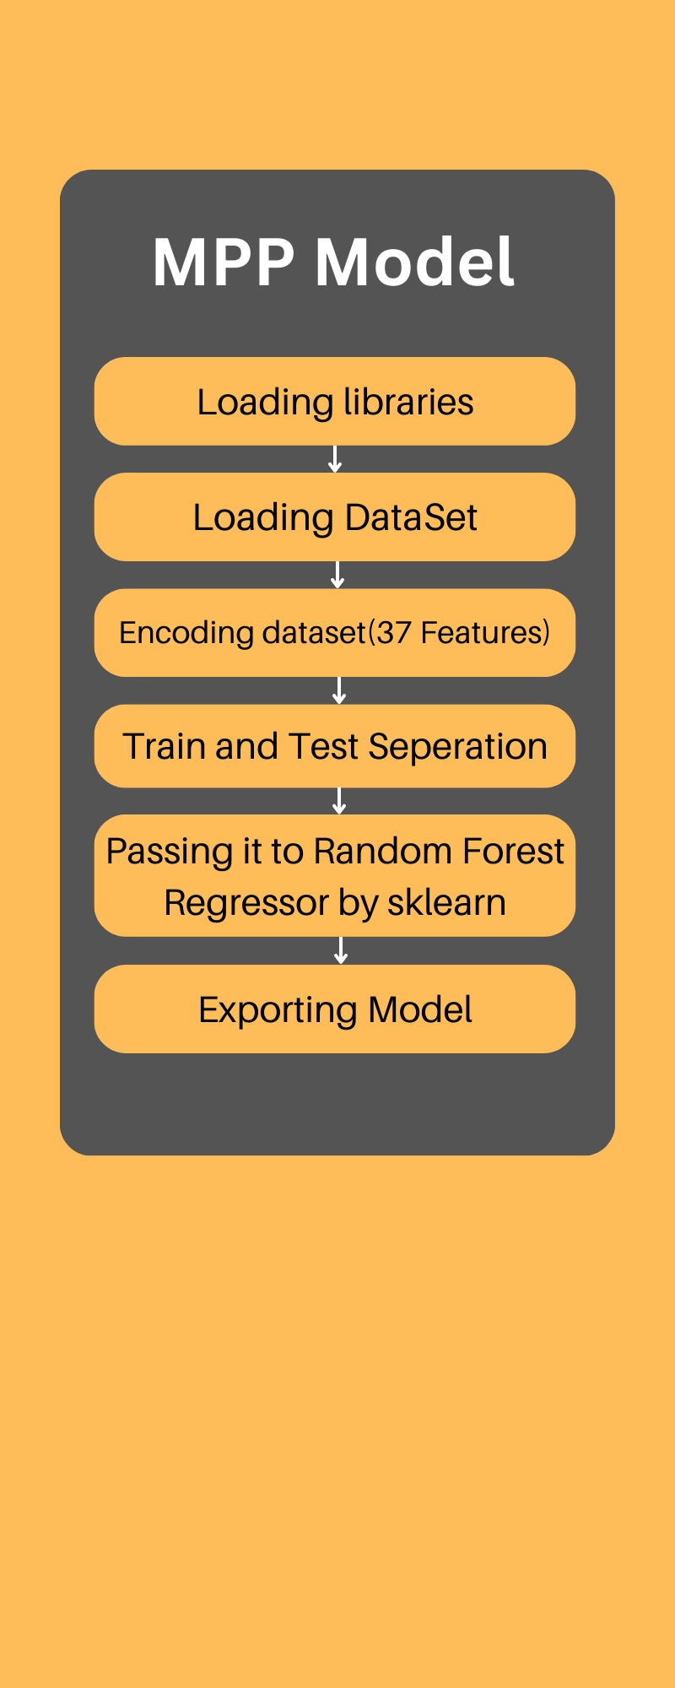
SYSTEM ARCHITECTURE
Fig 1
Fig 2
Fig.1: Architecture diagram of MPP Site
Fig.2: Architecture diagram of MPP Model

Slide 8
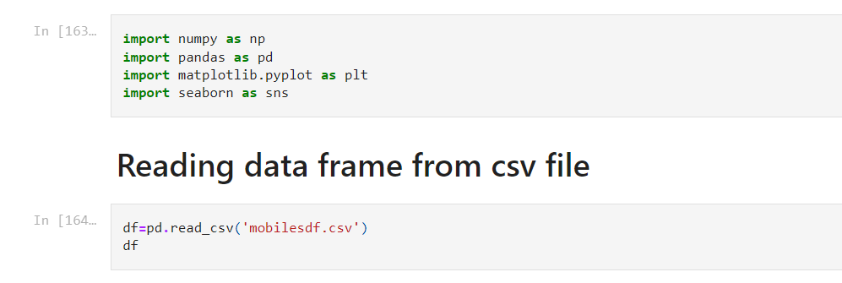
IMPLEMENTATION:

Slide 9
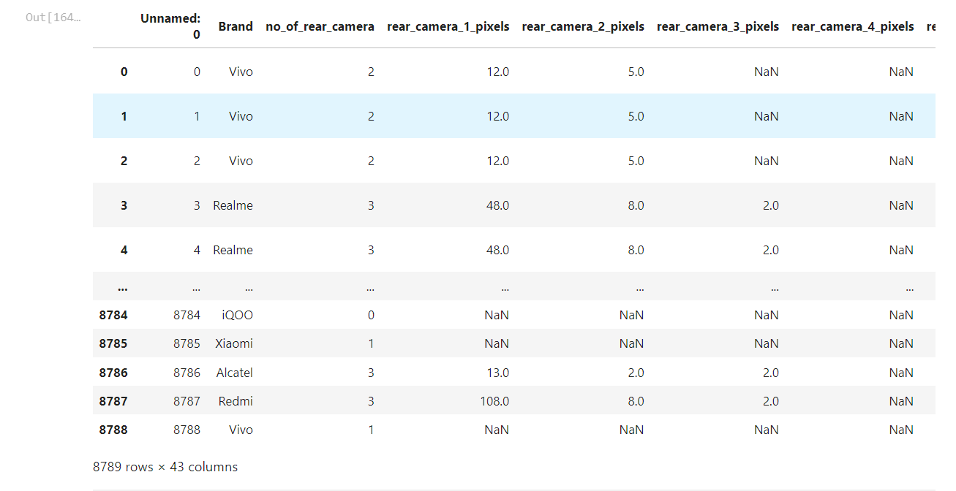
RESULTS:

Slide 10
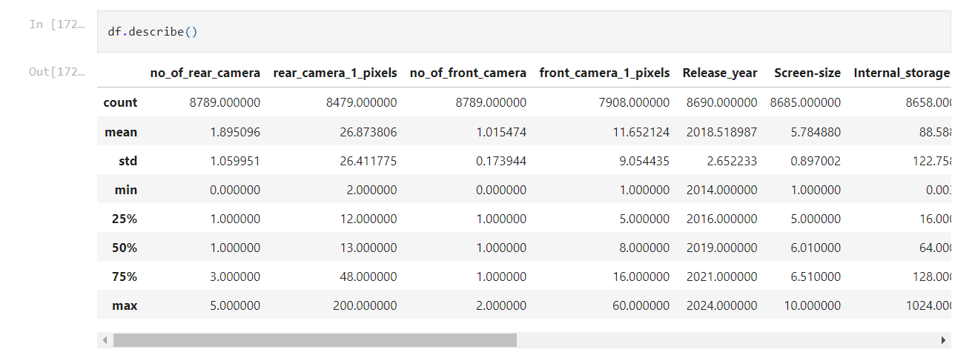
Describing the mean, std for continous vlaues

Slide 11
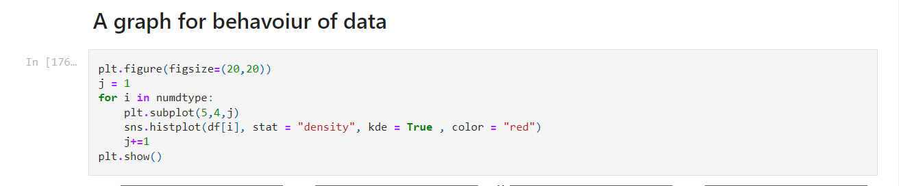
IMPLEMENTATION

Slide 12
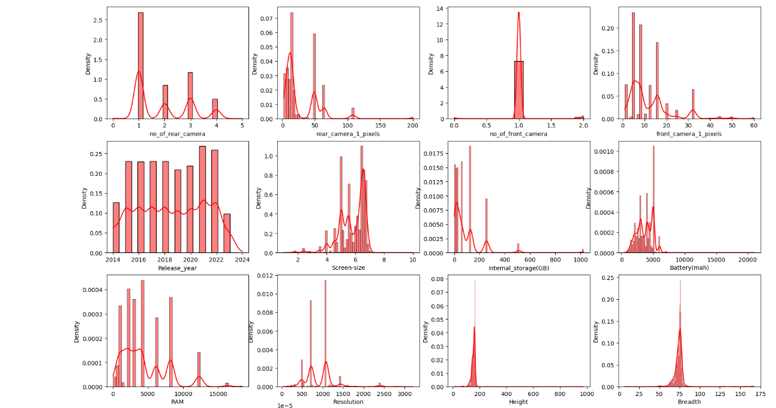
RESULTS:

Slide 13
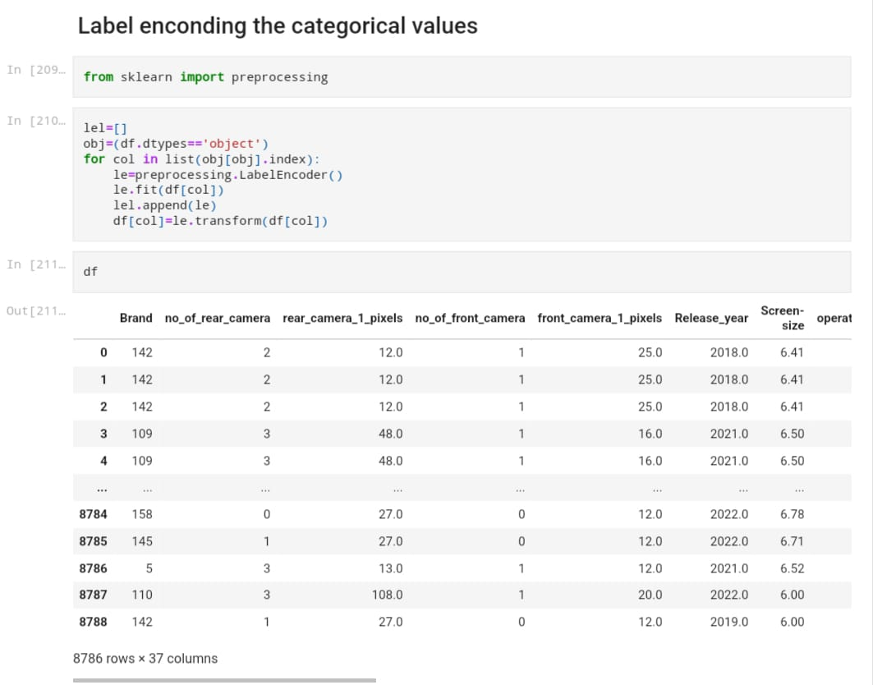
SAMPLE
CODE

Slide 14
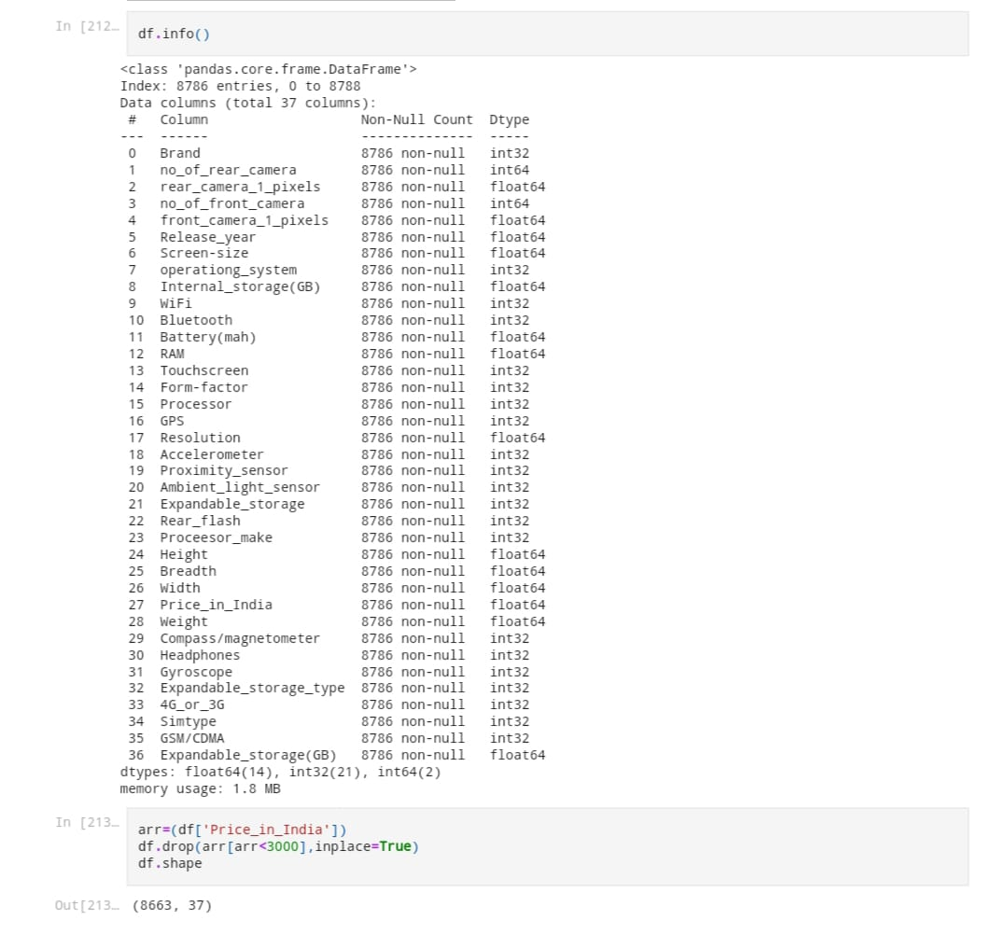
SAMPLE
CODE

Slide 15
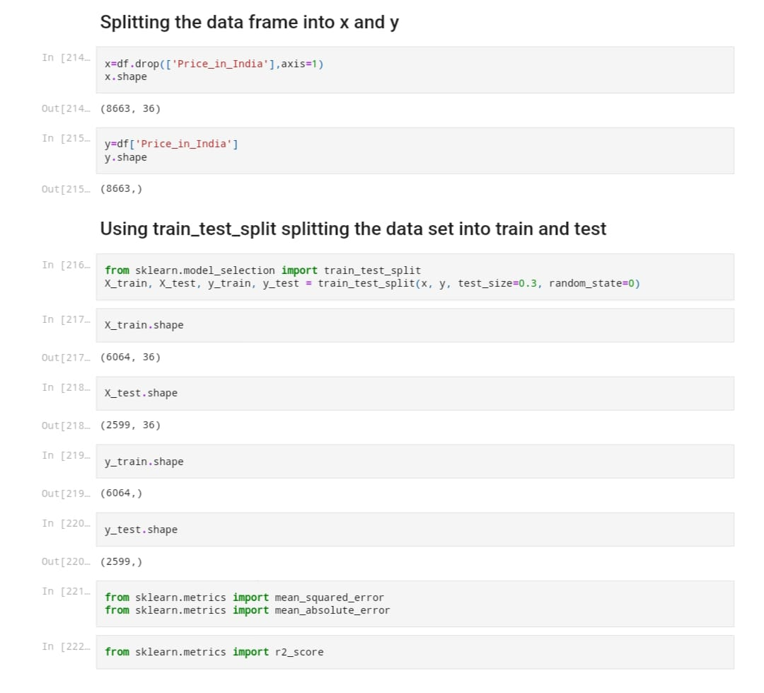
SAMPLE
CODE

Slide 16
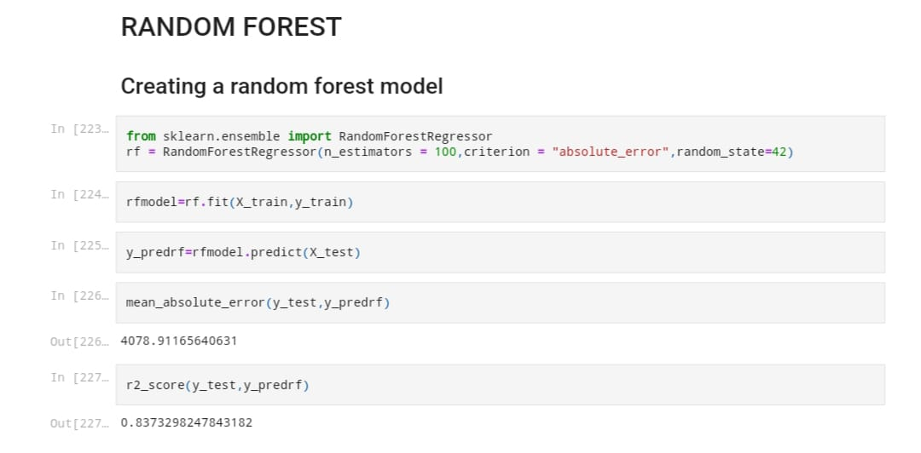

Slide 17
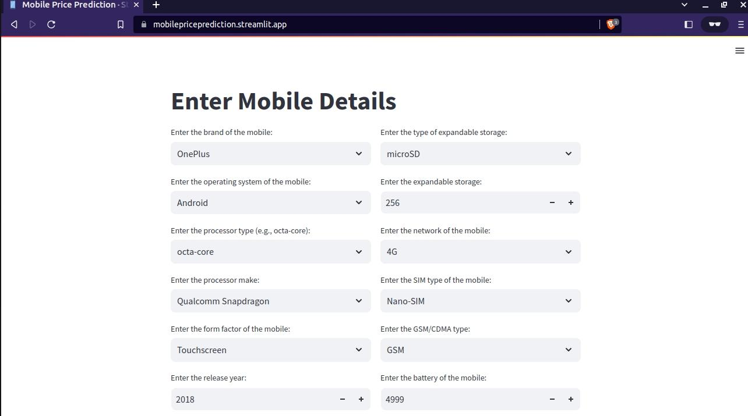

Slide 18
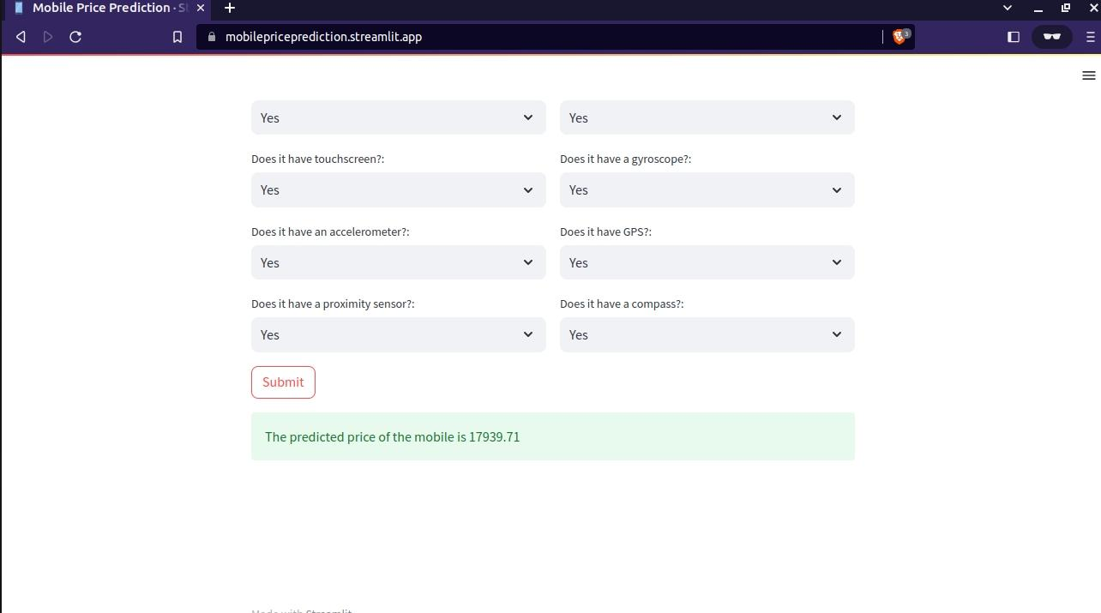

Slide 19
CONCLUSION
In conclusion, our project on smart mobile phone price prediction using machine learning has successfully empowered consumers to make informed purchasing decisions based on accurate price forecasts. By leveraging historical data and employing machine learning algorithms, we have developed a valuable tool that helps users assess the value of smartphones and avoid overpayment. Additionally, our project benefits industry stakeholders by providing insights into pricing strategies and market trends. With a user-friendly web interface, our project offers accessible and convenient access to our predictive model. Overall, our project enhances the consumer experience and contributes to a more informed mobile phone market.

Slide 20
REFERENCES:
[1] S. Subhiksha, Swathi Thota, J. Sangeetha: Prediction of Phone Prices Using Machine Learning Techniques. (09 January 2020)
http://dx.doi.org/10.1007/978-981-15-1097-7_65
[2]Nivitus : Mobile Price Prediction Using Machine Learning(July 2022)
https://medium.com/@Nivitus./mobile-price-prediction-using-machine-learning-fa9cab6fb242
[3] Pritish Arora, Sudhanshu Srivastava, Bindu Garg , ISSN: 2455-2631 Issue 4
Publishing date: Apr 2020
https://www.ijsdr.org/papers/IJSDR2004057.pdf
[4] Muhammad Asim, Zafar KhanMobile Price Class prediction using Machine Learning Techniques. International Journal of Computer Applications (0975 – 8887)
Volume 179 – No.29, March 2018
DOI:http://dx.doi.org/10.5120/ijca2018916555
[5]Prateek Majumder —
Learn Mobile Price Prediction Through Four Classification Algorithms Published On February 23, 2022 and Last Modified On March 22nd, 2022
https://www.analyticsvidhya.com/blog/2022/02/learn-mobile-price-prediction-through-four-classification-algorithms/
SOURCE CODE AND CONFIGURATION FILES https://github.com/W-A-R-L-U/intelrepo
Live Web Site [Demo] https://mobilepriceprediction.streamlit.app/

Slide 21
THANK YOU

